Slide 1
Dimension reduction
Lin zhang
Sse, tongji university
Dec. 2016

Slide 2





K-Nearest Neighbor
KNN is a supervised learning algorithm
Given a test sample, find its closest $k$ neighbors in the training set. Predict its label by the majority class of its $k$ neighbors
Voting or average
Weighted voting or average
Lazy learning vs. eager learning
$k=1→$ ? is +
$$P_{KNN}\left(err\right)≤2(1−P(c^{∗}|x))$$
$k=3→$ ? is -
+
-
$k=5→$ ? is +
+
?
test sample
-
+

Slide 3
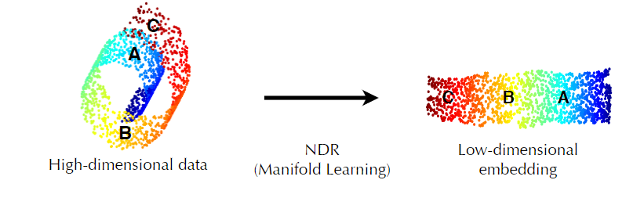
Low-dimensional embedding
High dimension results in sparse distribution of samples
Curse of dimensionality and dimension reduction
Low-dimensional embedding

Slide 4
Raw data can be complex, high-dimensional
To understand a phenomenon we measure various related quantities
If we knew what to measure or how to represent our measurements we might find simple relationships
But in practice we often measure redundant signals, e.g., US and European shoe sizes
We also represent data via the method by which it was gathered, e.g., pixel representation of brain imaging data

Slide 5
Dimensionality reduction
Issues
Measure redundant signals
Represent data via the method by which it was gathered
Goal: Find a ‘better’ representation for data
To visualize and discover hidden patterns
Preprocessing for supervised task
How do we define ‘better’?

Slide 6
E.g., Shoe size
We take noisy measurements on European and American scale
How can we do ‘better’, i.e., find a simpler, compact representation?
Pick a direction and project onto this direction
European Size
American Size

Slide 7
E.g., Shoe size
We take noisy measurements on European and American scale
How can we do ‘better’, i.e., find a simpler, compact representation?
Pick a direction and project onto this direction
European Size
American Size

Slide 8
Goal: Minimize reconstruction error
Minimize Euclidean distances between original points and their projections
PCA solution solves this problem!
PCA — reconstruct 2D data via 2D data with single degree of freedom. Evaluate reconstructions (represented by blue line) by Euclidean distances
European Size
American Size

Slide 9
Another goal: Maximize variance
To identify patterns we want to study variation across observations
Can we do ‘better’, i.e., find a compact representation that captures variation?
European Size
American Size

Slide 10
Another goal: Maximize variance
To identify patterns we want to study variation across observations
Can we do ‘better’, i.e., find a compact representation that captures variation?
PCA solution finds directions of maximal variance!
European Size
American Size

Slide 11


Principal Component Analysis (PCA)
Identify the orientation with largest variance
Suppose X contains n data points, and each data point is p-dimensional, that is
$X=\left\{x_{1},x_{2},…,x_{n}\right\}, x_{i}∈ℝ^{p×1},X∈ℝ^{p×n}$
Now, we want to find such a unit vector $α_{1}$,
$$α_{1}=\arg{\max_{α}{ var(α^{T}X)}, α∈ℝ^{p×1}}$$

Slide 12
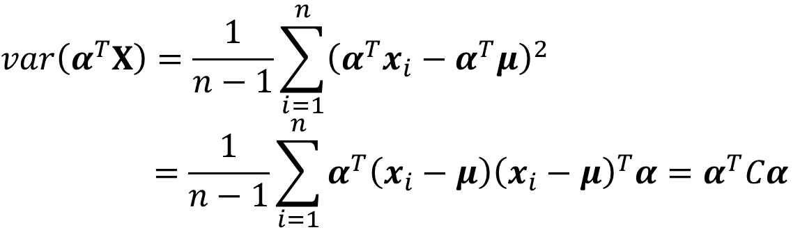
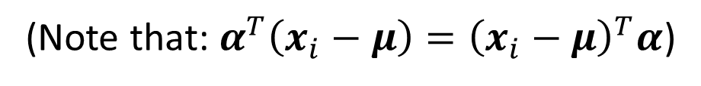
Principal Component Analysis (PCA)
Identify the orientation with largest variance
$$var\left(α^{T}X\right)=\frac{1}{n−1}\sum_{i=1}^{n}{{\left(α^{T}x_{i}−α^{T}μ\right)}^{2}}$$
$$=\frac{1}{n−1}\sum_{i=1}^{n}{α^{T}\left(x_{i}−μ\right){\left(x_{i}−μ\right)}^{T}α}=α^{T}Cα$$
(Note that: $α^{T}\left(x_{i}−μ\right)={\left(x_{i}−μ\right)}^{T}α$)
where
and is the covariance matrix

Slide 13


Principal Component Analysis (PCA)
Identify the orientation with largest variance
Since $α$ is unit, $α^{T}α=1$
Based on Lagrange multiplier method, we need to,
Since,
$α$is C’s eigen-vector

Slide 14
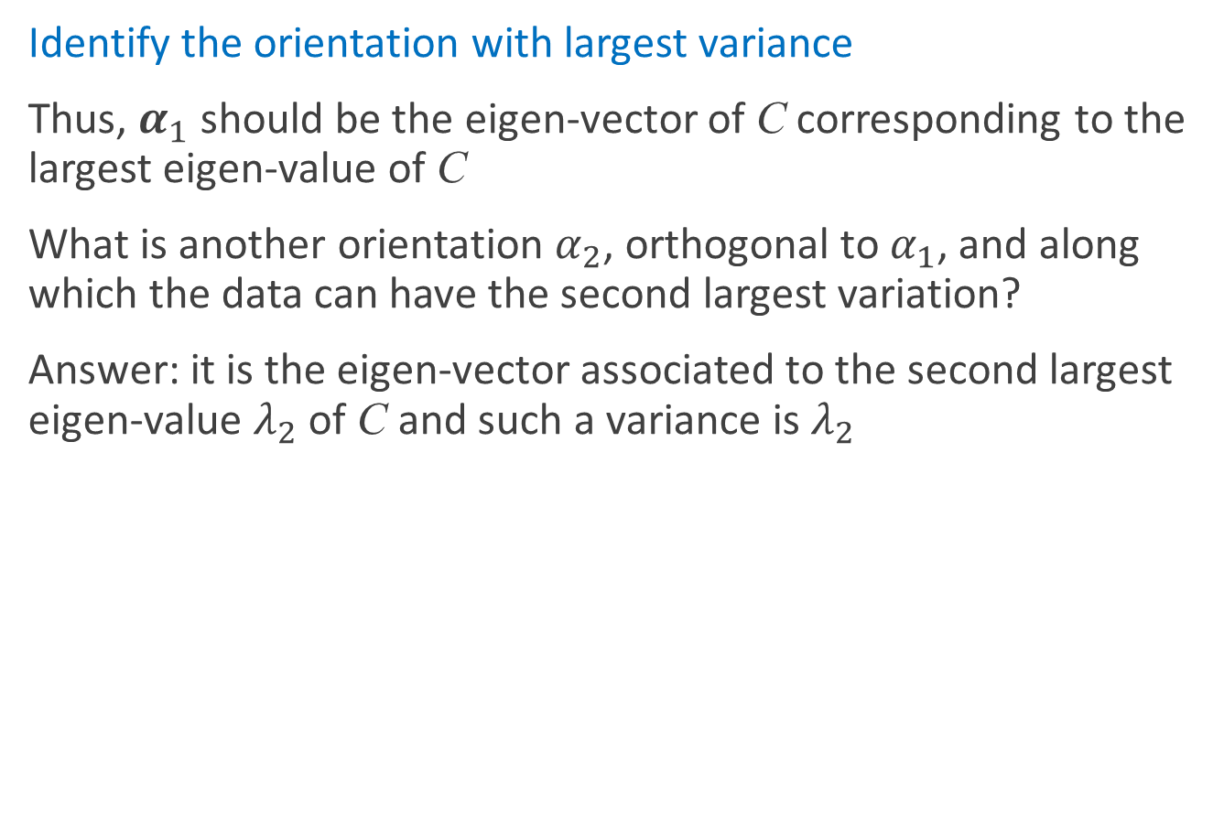
Principal Component Analysis (PCA)
Identify the orientation with largest variance
Thus, $α_{1}$ should be the eigen-vector of C corresponding to the largest eigen-value of C
What is another orientation $α_{2}$, orthogonal to $α_{1}$, and along which the data can have the second largest variation?
Answer: it is the eigen-vector associated to the second largest eigen-value $λ_{2}$ of C and such a variance is $λ_{2}$

Slide 15
Principal Component Analysis (PCA)
Identify the orientation with largest variance
Results: the eigen-vectors of C forms a set of orthogonal basis and they are referred as Principal Components of the original data X
You can consider PCs as a set of orthogonal coordinates. Under such a coordinate system, variables are not correlated.

Slide 16

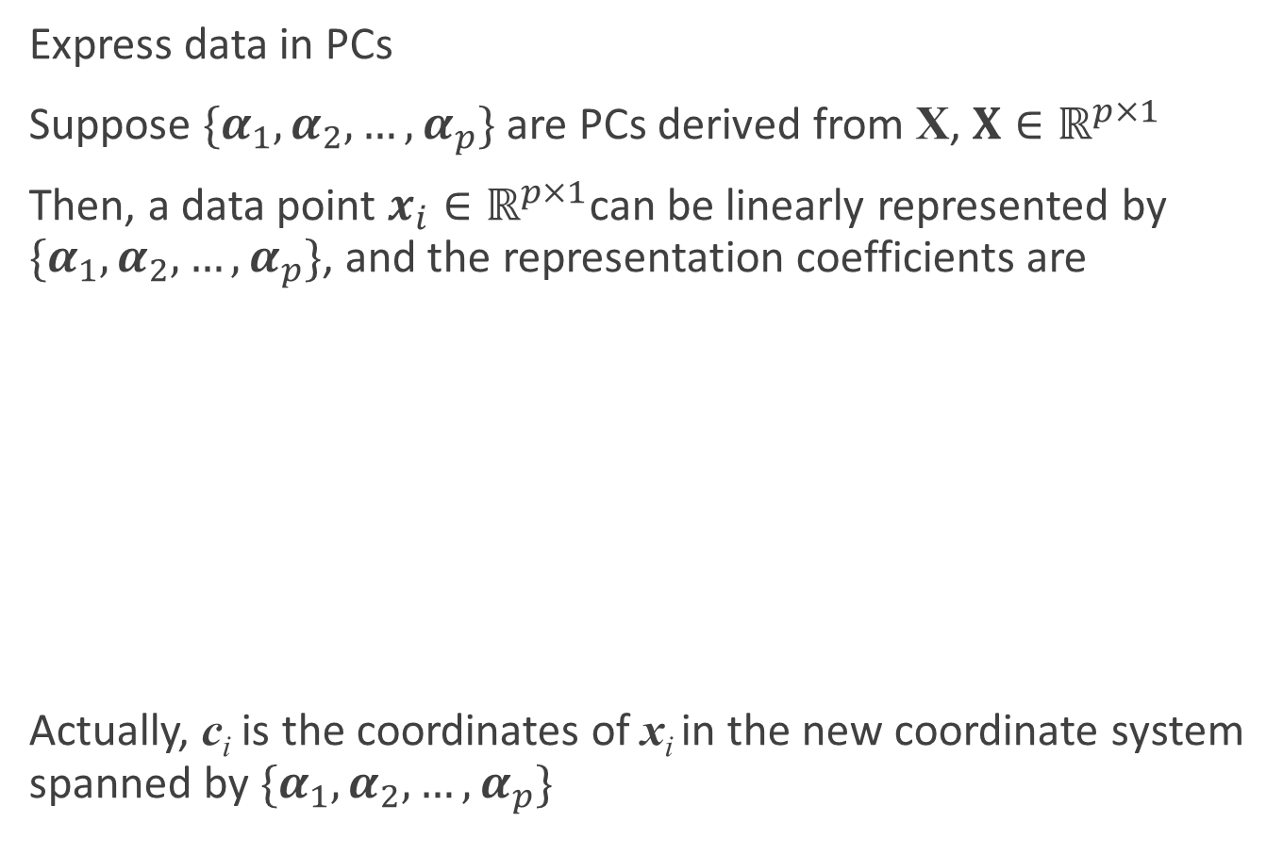
Principal Component Analysis (PCA)
Express data in PCs
Suppose $\{α_{1},α_{2},…,α_{p}\}$ are PCs derived from X, $X∈ℝ^{p×1}$
Then, a data point $x_{i}∈ℝ^{p×1}$can be linearly represented by $\{α_{1},α_{2},…,α_{p}\}$, and the representation coefficients are
Actually, c_{i} is the coordinates of x_{i} in the new coordinate system spanned by $\{α_{1},α_{2},…,α_{p}\}$
$$c_{i}=\left(\begin{aligned}\begin{matrix}α_{1}^{T} \\ α_{2}^{T} \\ ⋮\end{matrix} \\ α_{p}^{T}\end{aligned}\right)x_{i}$$

Slide 17

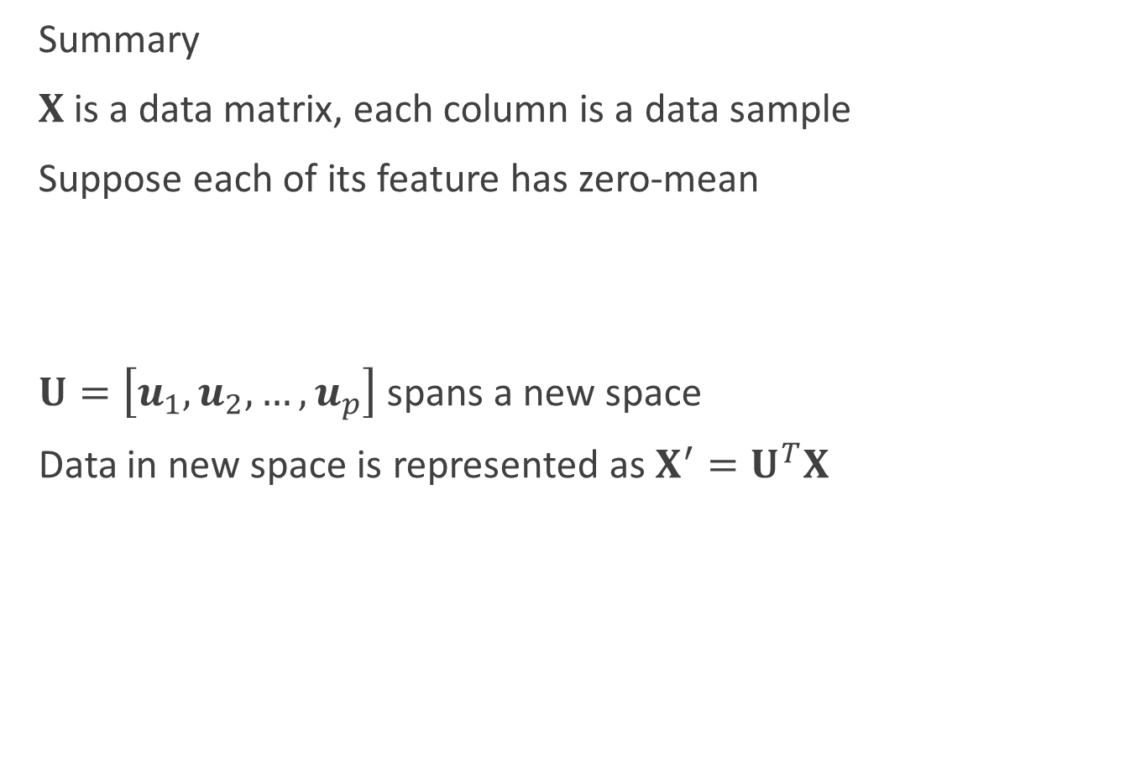
Principal Component Analysis (PCA)
Summary
$X$is a data matrix, each column is a data sample
Suppose each of its feature has zero-mean
$U=\left[u_{1},u_{2},…,u_{p}\right]$ spans a new space
Data in new space is represented as $X^{′}=U^{T}X$
In new space, dimensions of data are not correlated

Slide 18
Principal Component Analysis (PCA)
Illustration
x , y
(2.5, 2.4) (0.5, 0.7)
(2.2, 2.9)
(1.9, 2.2)
(3.1, 3.0)
(2.3, 2.7)
(2.0, 1.6)
(1.0, 1.1)
(1.5, 1.6)
(1.1, 0.9)
Eigen-values =
Corresponding eigen-vectors:

Slide 19
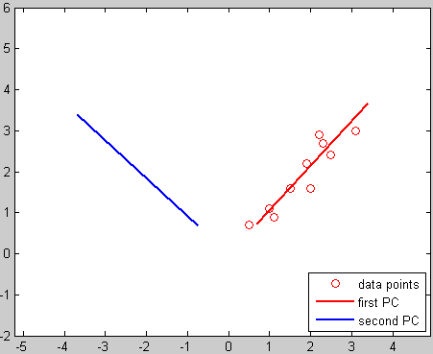
Principal Component Analysis (PCA)
Illustration

Slide 20
Principal Component Analysis (PCA)
Illustration
Coordinates of the data points in the new coordinate system

Slide 21
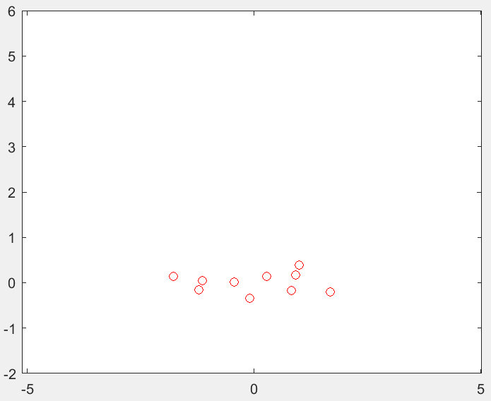
Principal Component Analysis (PCA)
Illustration
Coordinates of the data points in the new coordinate system
Draw newC on the plot
In such a new system, two variables are linearly independent!

Slide 22

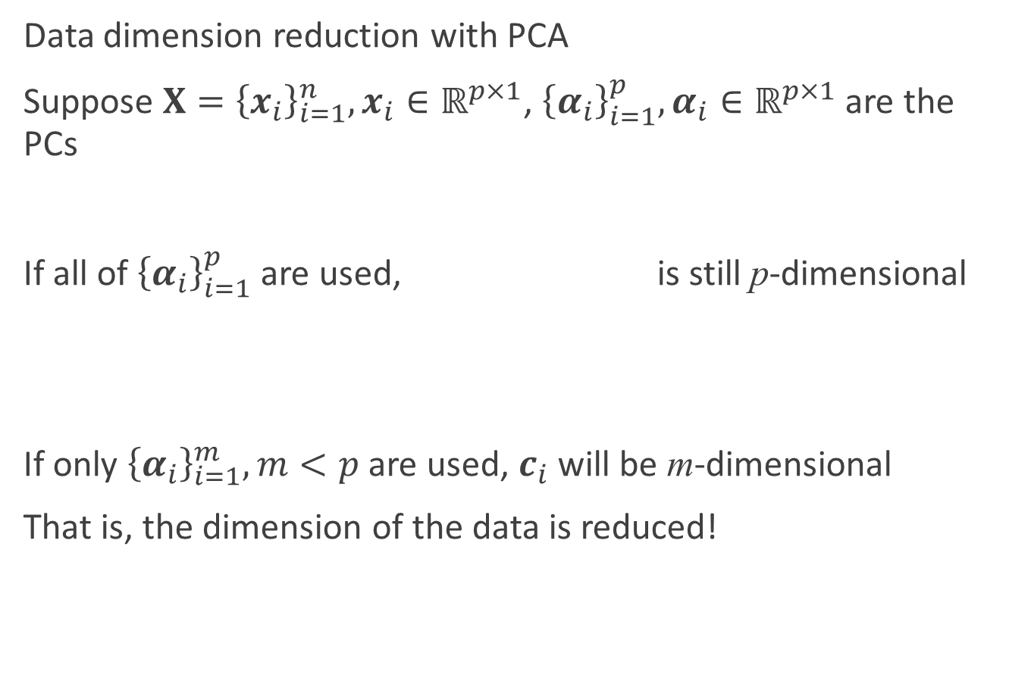
Principal Component Analysis (PCA)
Data dimension reduction with PCA
Suppose $X={\left\{x_{i}\right\}}_{i=1}^{n}, x_{i}∈ℝ^{p×1}$, ${\left\{α_{i}\right\}}_{i=1}^{p},α_{i}∈ℝ^{p×1}$ are the PCs
If all of ${\left\{α_{i}\right\}}_{i=1}^{p}$ are used, is still p-dimensional
If only ${\left\{α_{i}\right\}}_{i=1}^{m}, m<p$ are used, $c_{i}$ will be m-dimensional
That is, the dimension of the data is reduced!
$$c_{i}=\left(\begin{aligned}\begin{matrix}α_{1}^{T} \\ α_{2}^{T} \\ ⋮\end{matrix} \\ α_{p}^{T}\end{aligned}\right)x_{i}$$

Slide 23
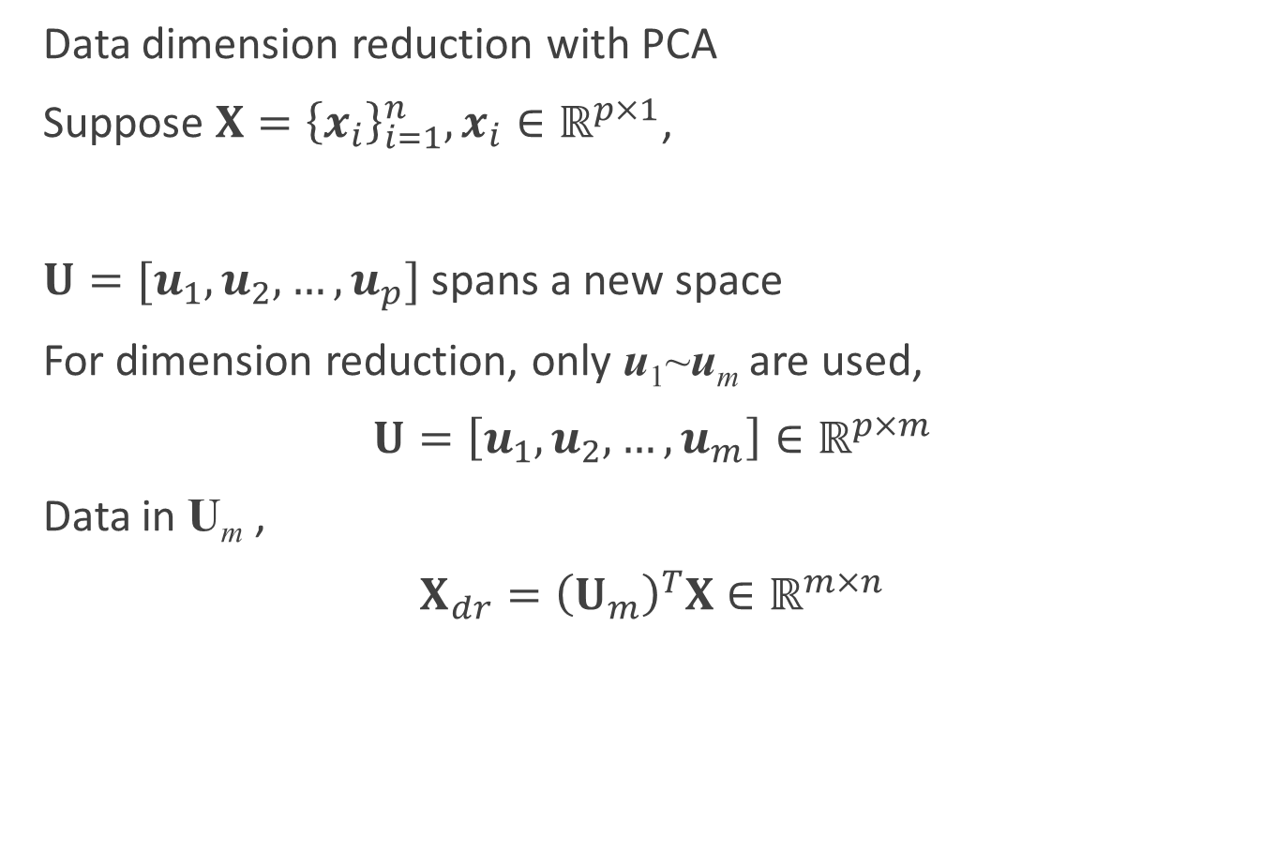
Principal Component Analysis (PCA)
Data dimension reduction with PCA
Suppose $X={\left\{x_{i}\right\}}_{i=1}^{n}, x_{i}∈ℝ^{p×1}$,
$U=[u_{1},u_{2},…,u_{p}]$ spans a new space
For dimension reduction, only u₁~u_{m} are used,
$U=\left[u_{1},u_{2},…,u_{m}\right]∈ℝ^{p×m}$
Data in U_{m} ,
$X_{dr}={\left(U_{m}\right)}^{T}X∈ℝ^{m×n}$

Slide 24
Principal Component Analysis (PCA)
Illustration
Coordinates of the data points in the new coordinate system
If only the first PC (corresponds to the largest eigen-value) is remained

Slide 25
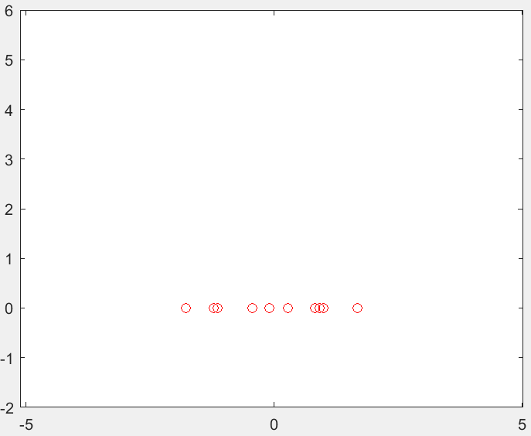
Principal Component Analysis (PCA)
Illustration
All PCs are used
Only 1 PC is used
Dimension reduction!

Slide 26
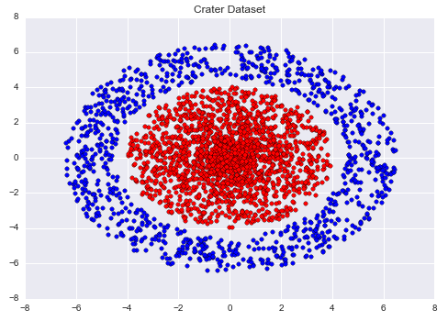
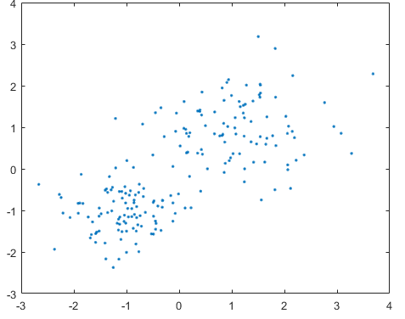
Metric learning
Each sample space defines a distance measure on attributes
Our goal is to find a sample space in which samples can be properly grouped under a proper distance measure
How?
We can learn a distance measure

Slide 27
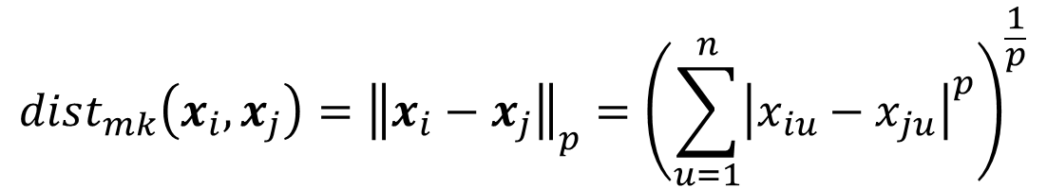

Distance measures
Some properties of a distance measure $dist(⋅,⋅)$:
Nonnegative: $dist\left(x_{i},x_{j}\right)≥0$
Identity: $dist\left(x_{i},x_{j}\right)=0 if and only ifx_{i}=x_{j}$
Symmetric: $dist\left(x_{i},x_{j}\right)=dist\left(x_{i},x_{i}\right)$
Triangle inequality: $dist\left(x_{i},x_{j}\right)≤dist\left(x_{i},x_{k}\right)+dist\left(x_{k},x_{j}\right)$
Minkowski distance
$$dist_{mk}\left(x_{i},x_{j}\right)={\left\|x_{i}−x_{j}\right\|}_{p}={\left(\sum_{u=1}^{n}{{\left|x_{iu}−x_{ju}\right|}^{p}}\right)}^{\frac{1}{p}}$$

Slide 28
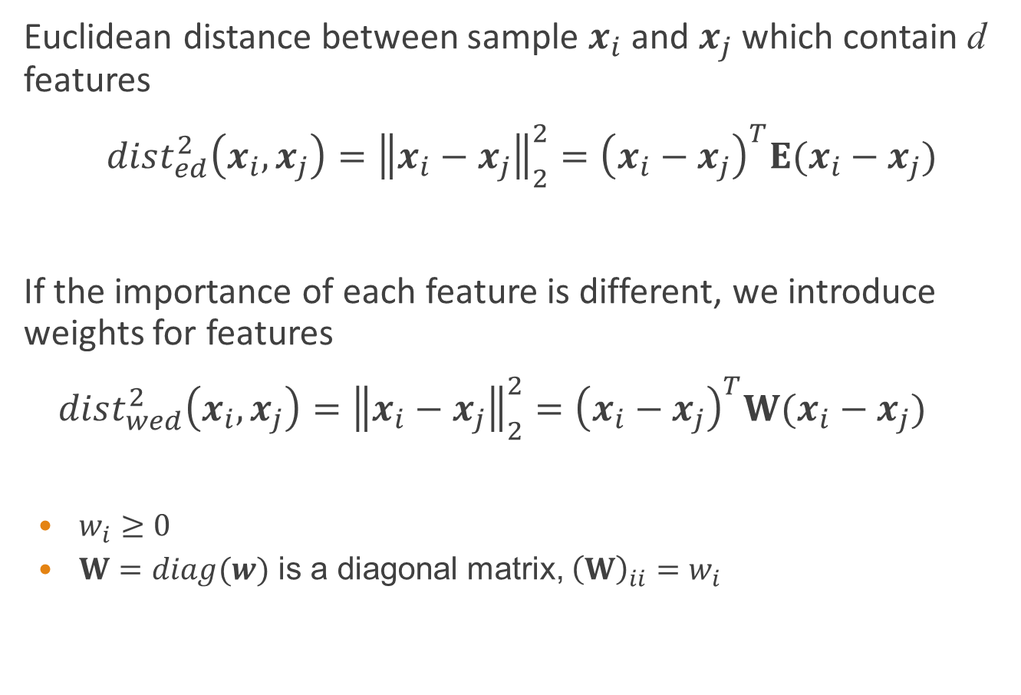
Extension of Euclidean distance
Euclidean distance between sample $x_{i}$ and $x_{j}$ which contain d features
$dist_{ed}^{2}\left(x_{i},x_{j}\right)={\left\|x_{i}−x_{j}\right\|}_{2}^{2}={\left(x_{i}−x_{j}\right)}^{T}E(x_{i}−x_{j})$
If the importance of each feature is different, we introduce weights for features
$dist_{wed}^{2}\left(x_{i},x_{j}\right)={\left\|x_{i}−x_{j}\right\|}_{2}^{2}={\left(x_{i}−x_{j}\right)}^{T}W(x_{i}−x_{j})$
$w_{i}≥0$
$W=diag(w)$ is a diagonal matrix, ${\left(W\right)}_{ii}=w_{i}$
$$=dist_{ij,1}^{2}+dist_{ij,2}^{2}+…+dist_{ij,d}^{2}$$
$$=w_{1}⋅dist_{ij,1}^{2}+w_{2}⋅dist_{ij,2}^{2}+…+w_{d}⋅dist_{ij,d}^{2}$$

Slide 29
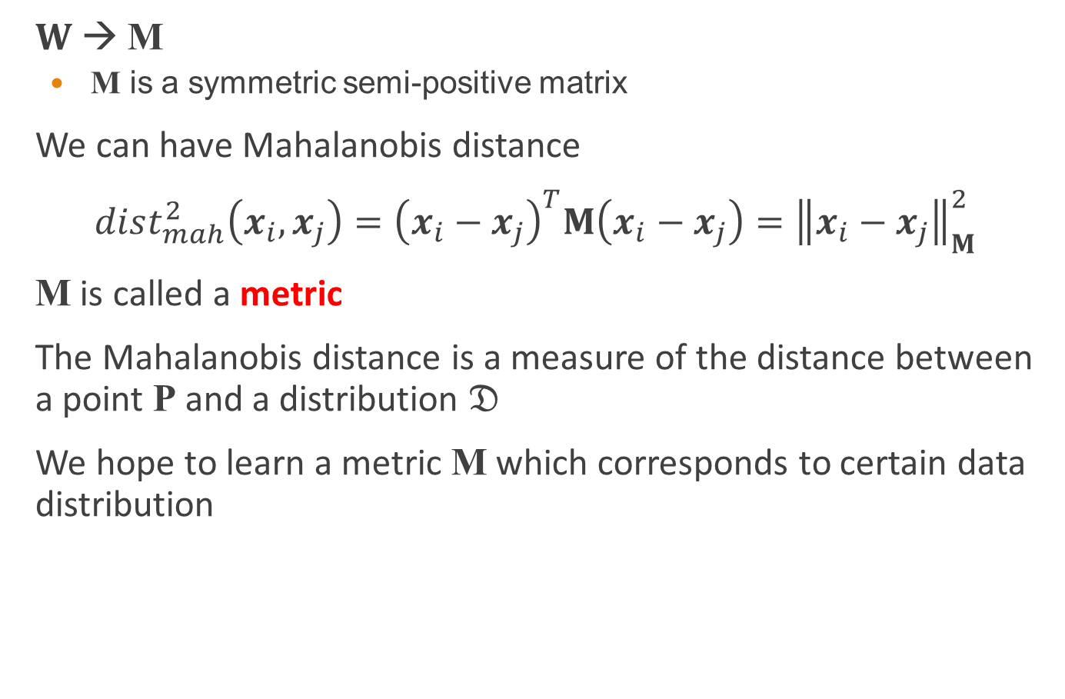
Mahalanobis distance
$W$ → M
M is a symmetric semi-positive matrix
We can have Mahalanobis distance
$dist_{mah}^{2}\left(x_{i},x_{j}\right)={\left(x_{i}−x_{j}\right)}^{T}M\left(x_{i}−x_{j}\right)={\left\|x_{i}−x_{j}\right\|}_{M}^{2}$
M is called a metric
The Mahalanobis distance is a measure of the distance between a point P and a distribution $𝔇$
We hope to learn a metric M which corresponds to certain data distribution

Slide 30
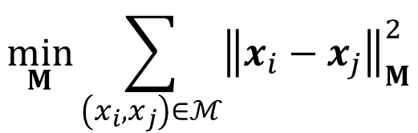


Learn a metric using priori knowledge
If some priori knowledge has been given
Must-link set $ℳ$: if $\left(x_{i},x_{j}\right)∈ℳ$, it means $x_{i}$and $x_{j}$ are similar
Cannot-link set $C$: if $\left(x_{i},x_{j}\right)∈C$, it means $x_{i}$and $x_{j}$ are dissimilar
We can find a metric M by solving the following optimization problem
$$\min_{M}{\sum_{\left(x_{i},x_{j}\right)∈ℳ}{{\left\|x_{i}−x_{j}\right\|}_{M}^{2}}}$$
$$s.t. \sum_{\left(x_{i},x_{j}\right)∈C}{{\left\|x_{i}−x_{j}\right\|}_{M}^{2}≥1}$$
$M≽0$

Slide 31

Dimension reduction using a learned metric
If the learned metric $M$ is a low-rank matrix, we can find a set of orthogonal basis of $M$ by performing eigenvalue decomposition
A matrix $P∈ℝ^{d×rank(M)}$ can be used to reduce dimensions of sample space

